Slide 1

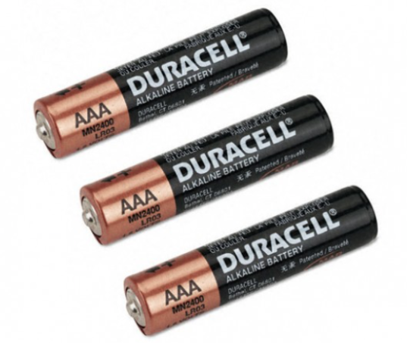
Quantum Repeater
Abdullah Al Shahir
Abdulrahman Al Swaji
Ahmed Al Hamed

Slide 2
Outline
What is Quantum internet?
Applications of Quantum Internet
Quantum Communication Challenges
No cloning theorem
Decoherence
Key Concepts of Quantum communication
Quantum Entanglement
Quantum Entanglement swapping
Quantum Teleportation
Quantum Repeater
What is Quantum Repeater?
Our work
Notes:
Quantum internet is an emerging paradigm in the field of quantum information science that aims to revolutionize the way information is transmitted and processed using the principles of quantum mechanics. Traditional classical communication networks rely on classical bits, which can represent either a 0 or a 1. Quantum internet, on the other hand, employs quantum bits, or qubits, which can exist in a superposition of both 0 and 1 states simultaneously. This property of qubits enables a range of unique and powerful capabilities for communication and computation.
Key Concepts of Quantum Internet:
Quantum Entanglement: Quantum entanglement is a phenomenon where two or more qubits become correlated in such a way that the state of one qubit instantly influences the state of another, regardless of the distance between them. This property is essential for secure quantum communication and forms the basis of quantum key distribution (QKD) protocols, ensuring unbreakable encryption.
Quantum Teleportation: Quantum teleportation is a process that allows the exact state of a qubit to be transmitted from one location to another without physically moving the qubit itself. It uses entanglement to recreate the state of the qubit at the destination.
Quantum Repeater: Quantum repeaters are devices designed to extend the range of quantum communication. As quantum signals tend to degrade over long distances due to various factors, repeaters are crucial for maintaining the integrity of the transmitted quantum information.
Quantum Gate Operations: Just as classical computers use logic gates for computations, quantum computers and quantum communication networks use quantum gates to manipulate qubits. Quantum gates perform operations that can entangle, disentangle, or transform qubits, enabling complex quantum computations and secure communication.
Quantum Algorithms and Protocols: Quantum internet can enable new algorithms and protocols that outperform classical counterparts in solving certain problems, such as factorizing large numbers or simulating quantum systems.

Slide 3
What is Quantum Internet?
A network of quantum computers that will someday
Send
Receive
information encoded in quantum states.
Compute

Slide 4
Applications of Quantum Internet
The quantum internet will not replace the modern or “classical” internet; instead, it will provide new functionalities such as :
Secure Communication:
Unbreakable encryption via QKD, ensuring privacy and data integrity.
Quantum Computing:
Distributed quantum computing using remote qubits for complex problem-solving.

Slide 5
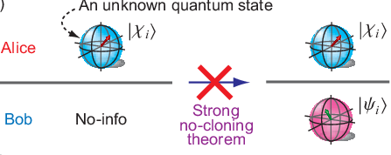
Quantum Communication Challenges
No-Cloning Theorem
It's a "double-edged sword" and limits the cloning of quantum states, enhancing security in quantum communication, yet also restricts the copying of quantum information for certain applications.

Slide 6
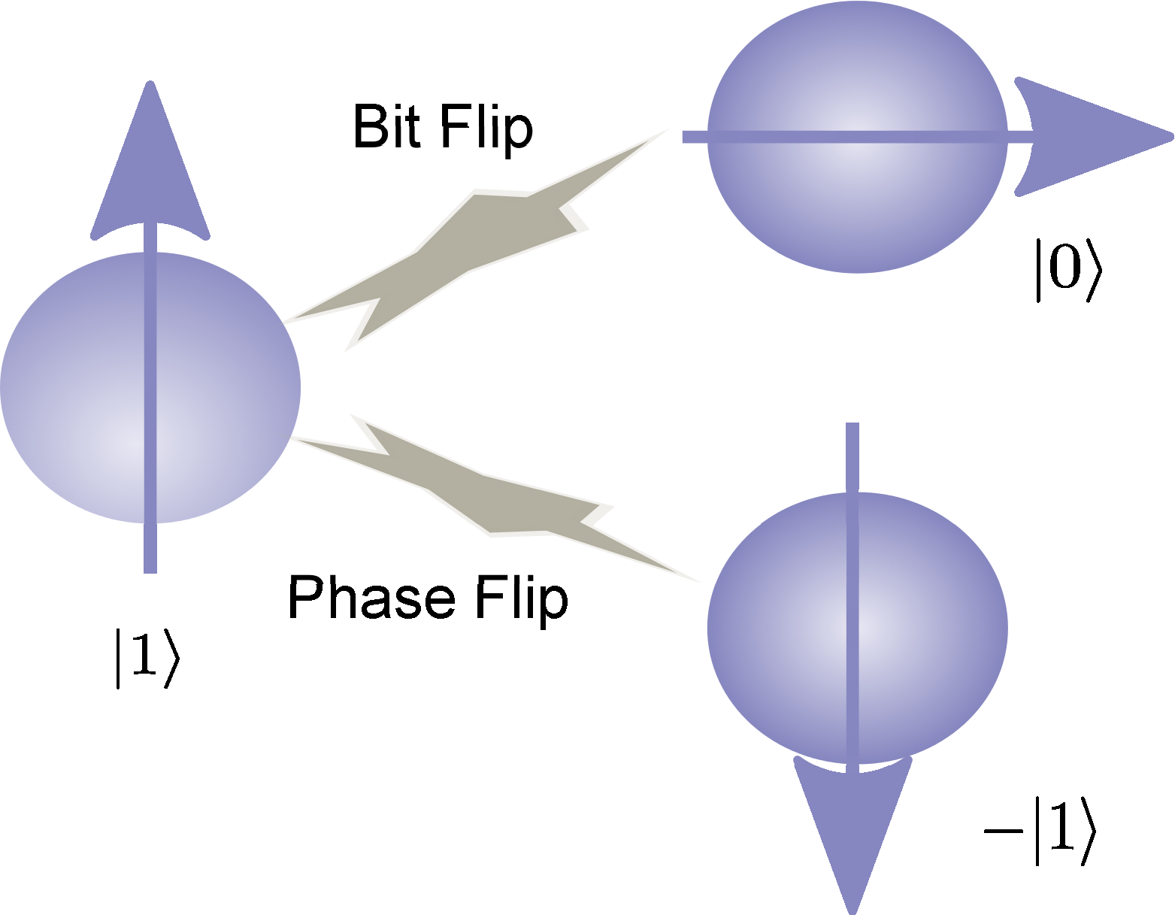
Quantum Communication Challenges
Decoherence
The loss of quantum information due to interactions with the environment, poses a significant challenge in maintaining the reliability and integrity of quantum communication.
Quantum Channel
Alice
Bob
The interactions with the environment in the Quantum Channel will lead to

Slide 7
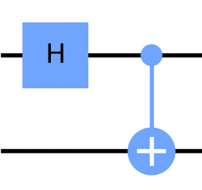
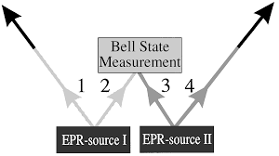
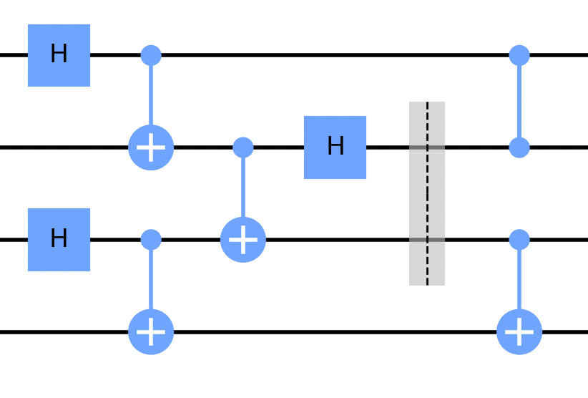
Key Concepts of Quantum Internet
Quantum Entanglement
Quantum Teleportation
Quantum Entanglement swapping
BSM
Alice
Channel
Bob

Slide 8
Bearing in mind the introduced challenges and concepts:
No-Cloning Theorem
Decoherence
Quantum Entanglement
Quantum Teleportation
Quantum Entanglement swapping

Slide 9
Quantum Repeater
The longer the distance in quantum communication, the greater the impact of decoherence
Quantum Channel
Alice
Bob
Quantum repeaters extend quantum communication range by breaking down long-distance channels into entangled shorter segments, mitigating decoherence.
Quantum Repeater
Quantum Channel
Quantum Channel
Alice
Bob

Slide 10
Quantum Repeater
Quantum Repeater
Quantum Entanglement
Quantum Entanglement swapping
Quantum Teleportation
Error Correction
Quantum Channel
Quantum Channel
Alice
Bob

Slide 11
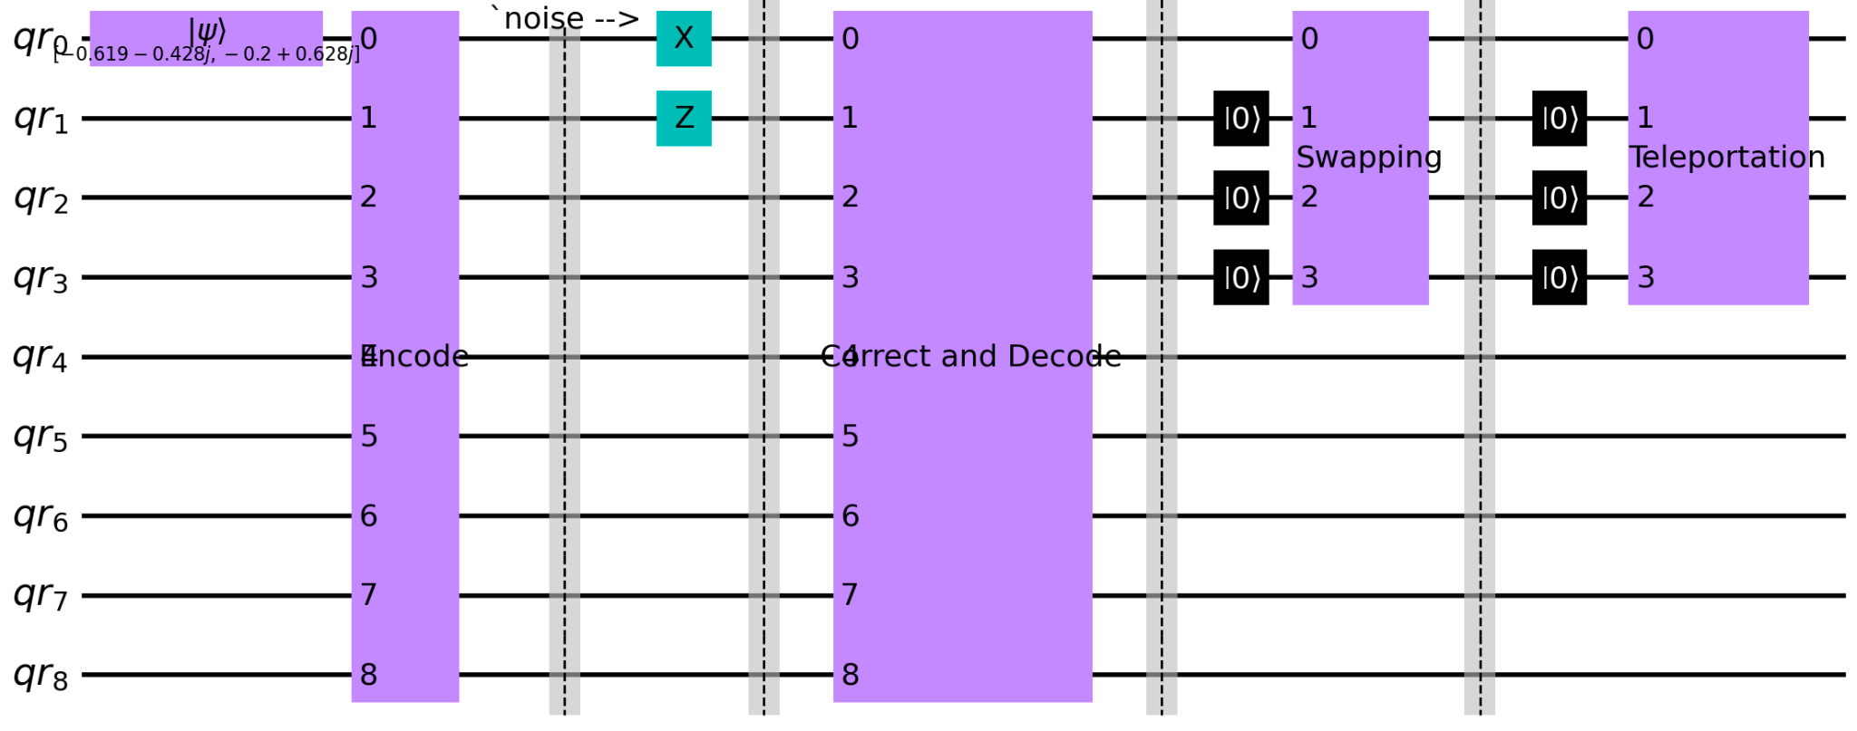
Circuit Design

Slide 12

Show Our Result

Slide 13
What is next?
To replace the error correction mechanism that we used which is Shore code and discover more about Quantum purification to be implemented for better result.

Slide 14
Project Outcome
Concept
Circuits
Ideal experiment outcome
Simulators

